Slide 1

Unit - III
Business Continuity and Backup Recovery

Slide 2
Unit – III
Business Continuity and Backup Recovery
Information Availability
BC Terminology, BC Planning life cycle
Failure Analysis, Business Impact Analysis
BC Technology Solutions
Backup and Archive: Backup Purpose
Backup Considerations
Backup Granularity , Recovery considerations
Backup Methods, Backup Architecture
Backup and Restore Operations
Backup Topologies
Backup in NAS Environments
Backup Targets, Data Deduplication for Backup
Backup in Virtualized Environments
Sharing Files between host and Virtual Machines, Usage of Backup techniques

Slide 3
Business Continuity and Backup Recovery
In today’s world, continuous access to information is a must for the smooth functioning of business operations.
The cost of unavailability of information is greater than ever, and outages in key industries cost millions of dollars per hour.
There are many threats to information availability, such as natural disasters, unplanned occurrences, and planned occurrences, that could result in the inaccessibility of information.
Therefore it is critical for businesses to define an appropriate strategy that can help them overcome these crises.
Business continuity is an important process to define and implement these strategies

Slide 4
Business Continuity and Backup Recovery
Business continuity (BC) is an integrated and enterprise-wide process that includes all activities (internal and external to IT) that a business must perform to mitigate the impact of planned and unplanned downtime
BC entails preparing for, responding to, and recovering from a system outage that adversely affects business operations.

Slide 5
Business Continuity and Backup Recovery
It involves proactive and reactive measures
Proactive Measures
  Business Impact Analysis
  Risk Assessments
  BC technology solutions deployment (backup and replication)
Reactive Measures
  Disaster recovery and restart, to be invoked in the event of a failure.

Slide 6
Business Continuity and Backup Recovery
The goal of a BC solution is to ensure the “information availability” required to conduct vital business operations.
In a virtualized environment, BC technology solutions need to protect both physical and virtualized resources.
Virtualization considerably simplifies the implementation of BC strategy and solutions.

Slide 7
Information availability
Information Availability (IA) refers to the ability of an IT infrastructure to function according to business expectations during its specified time of operation.
IA ensures that people (employees, customers, suppliers, and partners) can access information whenever they need it.
IA can be defined in terms of accessibility, reliability, and timeliness of information.

Slide 8
Information availability
Causes of Information Unavailability
Various planned and unplanned incidents result in information unavailability.
Planned outages include installation/integration/maintenance of new hardware, software upgrades or patches, taking backups, application and data restores, facility operations (renovation and construction), and refresh/migration of the testing to the production environment.
Unplanned outages include failure caused by human errors, database corruption, and failure of physical and virtual components.

Slide 9
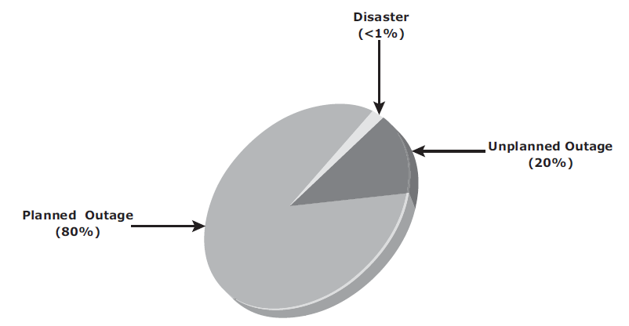
Information availability
Causes of Information Unavailability
Another type of incident that may cause data unavailability is natural or manmade disasters, such as flood, fire, earthquake, and contamination.
As illustrated in below figure, the majority of outages are planned.

Slide 10
Information availability
Causes of Information Unavailability
Planned outages are expected and scheduled but still cause data to be unavailable.
Statistically, the cause of information unavailability due to unforeseen disasters is less than 1 percent.

Slide 11
Information availability
Consequences of Downtime
Information unavailability or downtime results in
    loss of productivity
    loss of revenue
    poor financial performance and
    damage to reputation.
Loss of productivity includes reduced output per unit of labor, equipment, and capital.
Loss of revenue includes direct loss, compensatory payments, future revenue loss, billing loss, and investment loss.

Slide 12
Information availability
Consequences of Downtime
Poor financial performance affects revenue recognition, cash flow, discounts, payment guarantees, credit rating, and stock price.
Damages to reputations may result in a loss of confidence or credibility with customers, suppliers, financial markets, banks, and business partners.
Other possible consequences of downtime include the cost of additional equipment rental, overtime, and extra shipping.

Slide 13
Information availability
Consequences of Downtime
The business impact of downtime is the sum of all losses sustained as a result of a given disruption.
An important metric, average cost of downtime per hour, provides a key estimate in determining the appropriate BC solutions.

Slide 14
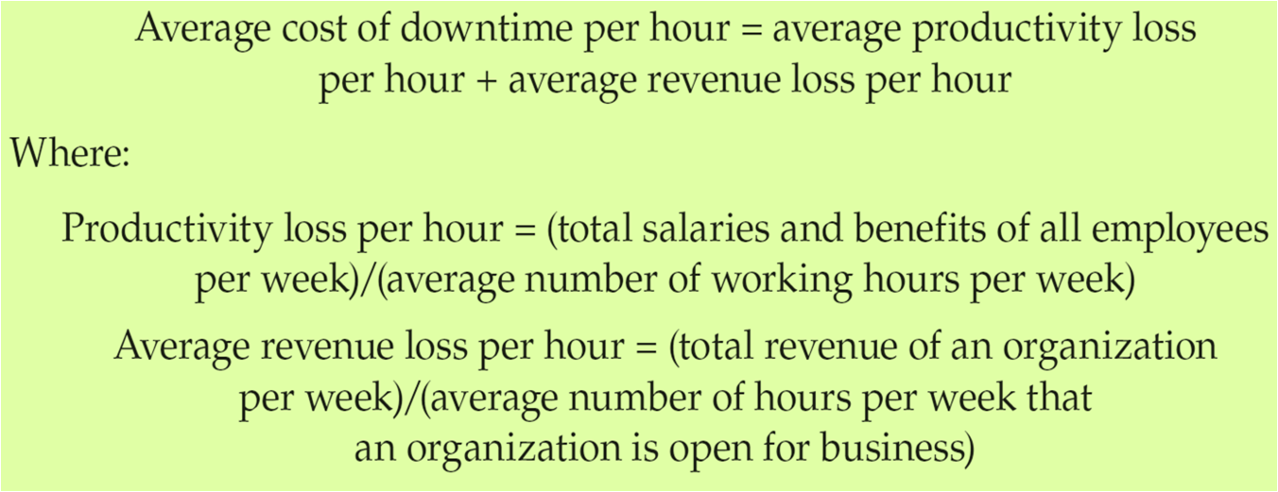
Information availability
Consequences of Downtime
It is calculated as follows:
The average downtime cost per hour may also include estimates of projected revenue loss due to other consequences, such as damaged reputations, and the additional cost of repairing the system

Slide 15
Information availability
Measuring Information Availability
IA relies on the availability of both physical and virtual components of a data center.
Failure of these components might disrupt IA.
A failure is the termination of a component’s capability to perform a required function.
The component’s capability can be restored by performing an external corrective action, such as a manual reboot, repair, or replacement of the failed component(s).

Slide 16
Information availability
Measuring Information Availability
Repair involves restoring a component to a condition that enables it to perform a required function.
Proactive risk analysis, performed as part of the BC planning process, considers the component failure rate and average repair time, which are measured by
  Mean Time Between Failure (MTBF) and
  Mean Time To Repair (MTTR)

Slide 17
Information availability
Measuring Information Availability
Mean Time Between Failure (MTBF): It is the average time available for a system or component to perform its normal operations between failures.
It is the measure of system or component reliability and is usually expressed in hours.

Slide 18
Information availability
Measuring Information Availability
Mean Time To Repair (MTTR): It is the average time required to repair a failed component.
While calculating MTTR, it is assumed that the fault responsible for the failure is correctly identified and the required spares and personnel are available.
A fault is a physical defect at the component level, which may result in information unavailability.

Slide 19
Information availability
Measuring Information Availability
MTTR includes the total time required to do the following activities:
    Detect the fault
    mobilize the maintenance team
    diagnose the fault
    obtain the spare parts
    repair,
    test, and
    restore the data.

Slide 20
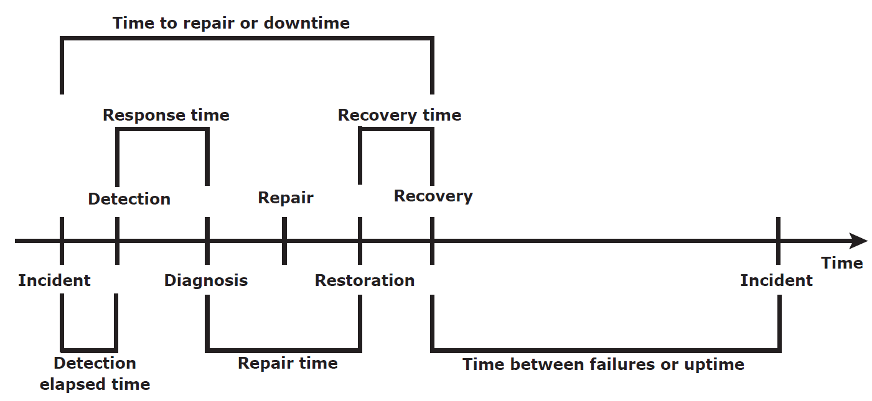
Information availability
Measuring Information Availability
Following figure illustrates the various information availability metrics that represent system uptime and downtime.

Slide 21
Information availability
Measuring Information Availability
IA is the time period during which a system is in a condition to perform its intended function upon demand.
It can be expressed in terms of system uptime and downtime and measured as the amount or percentage of system uptime:
IA = system uptime/(system uptime + system downtime)
Where system uptime is the period of time during which the system is in an accessible state; when it is not accessible, it is termed as system downtime.

Slide 22
Information availability
Measuring Information Availability
In terms of MTBF and MTTR, IA could also be expressed as
IA = MTBF/(MTBF + MTTR)
Uptime per year is based on the exact timeliness requirements of the service.
This calculation leads to the number of “9s” representation for availability metrics.

Slide 23
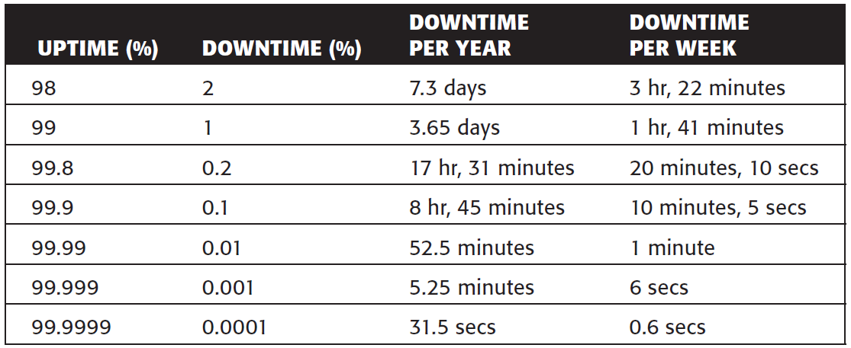
Information availability
Measuring Information Availability
Below Table lists the approximate amount of downtime allowed for a service to achieve certain levels of 9s availability.
For example, a service that is said to be “five 9s available” is available for 99.999 percent of the scheduled time in a year (24 × 365).

Slide 24
BC Terminology
Disaster recovery: This is the coordinated process of restoring systems, data, and the infrastructure required to support ongoing business operations after a disaster occurs.
It is the process of restoring a previous copy of the data and applying logs or other necessary processes to that copy to bring it to a known point of consistency.
After all recovery efforts are completed, the data is validated to ensure that it is correct.

Slide 25
BC Terminology
Disaster restart: This is the process of restarting business operations with mirrored consistent copies of data and applications.
Recovery-Point Objective (RPO): This is the point in time to which systems and data must be recovered after an outage.
It defines the amount of data loss that a business can endure.
A large RPO signifies high tolerance to information loss in a business.
Based on the RPO, organizations plan for the frequency with which a backup or replica must be made.
For example, if the RPO is 6 hours, backups or replicas must be made at least once in 6 hours

Slide 26
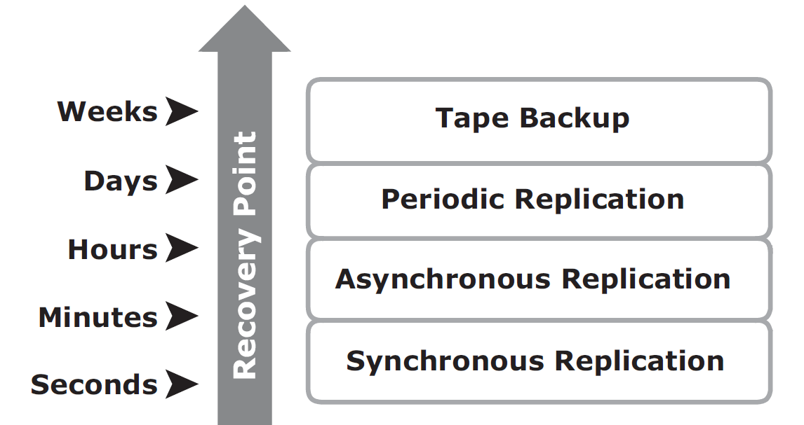
BC Terminology
Below figure shows various RPOs and their corresponding ideal recovery strategies.

Slide 27
BC Terminology
An organization can plan for an appropriate BC technology solution on the basis of the RPO it sets. For example:
RPO of 24 hours: Backups are created at an offsite tape library every midnight. The corresponding recovery strategy is to restore data from the set of last backup tapes.
RPO of 1 hour: Shipping database logs to the remote site every hour. The corresponding recovery strategy is to recover the database to the point of the last log shipment.
RPO in the order of minutes: Mirroring data asynchronously to a remote site
Near zero RPO: Mirroring data synchronously to a remote site

Slide 28
BC Terminology
Recovery-Time Objective (RTO): The time within which systems and applications must be recovered after an outage.
It defines the amount of downtime that a business can endure and survive.
Businesses can optimize disaster recovery plans after defining the RTO for a given system.
For example, if the RTO is 2 hours, it requires disk-based backup because it enables a faster restore than a tape backup.
However, for an RTO of 1 week, tape backup will likely meet the requirements.

Slide 29
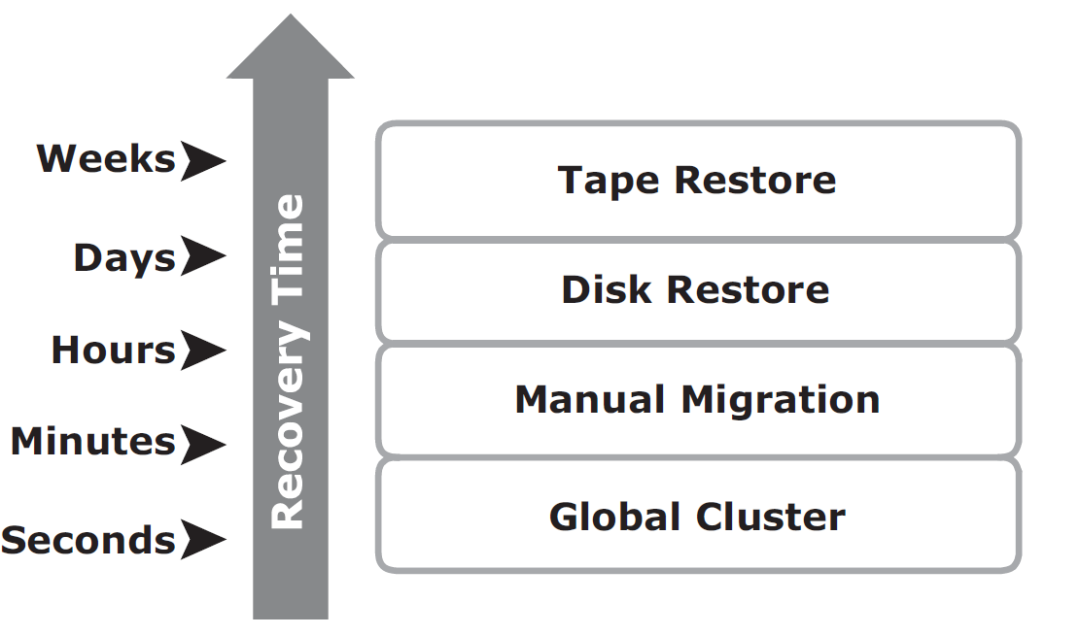
BC Terminology
Recovery-time objective

Slide 30
BC Terminology
Some examples of RTOs and the recovery strategies to ensure data availability are listed here
RTO of 72 hours: Restore from tapes available at a cold site.
RTO of 12 hours: Restore from tapes available at a hot site.
RTO of few hours: Use of data vault at a hot site
RTO of a few seconds: Cluster production servers with bidirectional mirroring, enabling the applications to run at both sites simultaneously.

Slide 31
BC Terminology
Data vault: A repository at a remote site where data can be periodically or continuously copied (either to tape drives or disks) so that there is always a copy at another site
Hot site: A site where an enterprise’s operations can be moved in the event of disaster.
It is a site with the required hardware, operating system, application, and network support to perform business operations, where the equipment is available and running at all times.

Slide 32
BC Terminology
Cold site: A site where an enterprise’s operations can be moved in the event of disaster, with minimum IT infrastructure and environmental facilities in place, but not activated
Server Clustering: A group of servers and other necessary resources coupled to operate as a single system. Clusters can ensure high availability and load balancing.
Typically, in failover clusters, one server runs an application and updates the data, and another server is kept as standby to take over completely, as required.
In more sophisticated clusters, multiple servers may access data, and typically one server is kept as standby.
Server clustering provides load balancing by distributing the application load evenly among multiple servers within the cluster.

Slide 33
BC Planning life cycle
BC planning must follow a disciplined approach like any other planning process.
Organizations today dedicate specialized resources to develop and maintain BC plans.
From the conceptualization to the realization of the BC plan, a life cycle of activities can be defined for the BC process.
The BC planning life cycle includes five stages

Slide 34
BC Planning life cycle
The BC planning life cycle includes five stages
    Establishing objectives
    Analyzing
    Designing and developing
    Implementing
    Training, testing, assessing, and maintaining

Slide 35
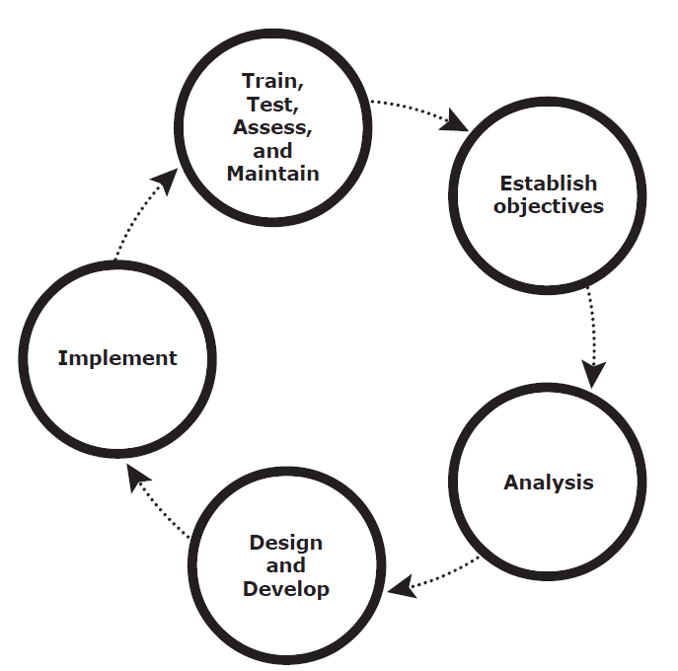
BC Planning life cycle
BC planning life cycle

Slide 36
BC Planning life cycle
Several activities are performed at each stage of the BC planning life cycle, including the following key activities:
1. Establishing objectives
Determine BC requirements.
Estimate the scope and budget to achieve requirements.
Select a BC team that includes subject matter experts from all areas of the business, whether internal or external.
Create BC policies.

Slide 37
BC Planning life cycle
2. Analyzing
Collect information on data profiles, business processes, infrastructure support, dependencies, and frequency of using business infrastructure.
Conduct a Business Impact Analysis (BIA).
Identify critical business processes and assign recovery priorities.
Perform risk analysis for critical functions and create mitigation strategies.
Perform cost benefit analysis for available solutions based on the mitigation strategy.
Evaluate options.

Slide 38
BC Planning life cycle
3. Design and develop
Define the team structure and assign individual roles and responsibilities. For example, different teams are formed for activities, such as emergency response, damage assessment, and infrastructure and application recovery.
Design data protection strategies and develop infrastructure.
Develop contingency solutions.
Develop emergency response procedures.
Detail recovery and restart procedures.

Slide 39
BC Planning life cycle
4. Implement
Implement risk management and mitigation procedures that include backup, replication, and management of resources.
Prepare the disaster recovery sites that can be utilized if a disaster affects the primary data center.
Implement redundancy for every resource in a data center to avoid single points of failure.

Slide 40
BC Planning life cycle
5. Train, test, assess, and maintain
Train the employees who are responsible for backup and replication of business-critical data on a regular basis or whenever there is a modification in the BC plan.
Train employees on emergency response procedures when disasters are declared.
Train the recovery team on recovery procedures based on contingency scenarios.

Slide 41
BC Planning life cycle
5. Train, test, assess, and maintain (Contd..)
Perform damage-assessment processes and review recovery plans.
Test the BC plan regularly to evaluate its performance and identify its limitations.
Assess the performance reports and identify limitations.
Update the BC plans and recovery/restart procedures to reflect regular changes within the data center.

Slide 42
Failure Analysis
Failure analysis involves analyzing both the physical and virtual infrastructure components to identify systems that are susceptible to a single point of failure and implementing fault-tolerance mechanisms.

Slide 43
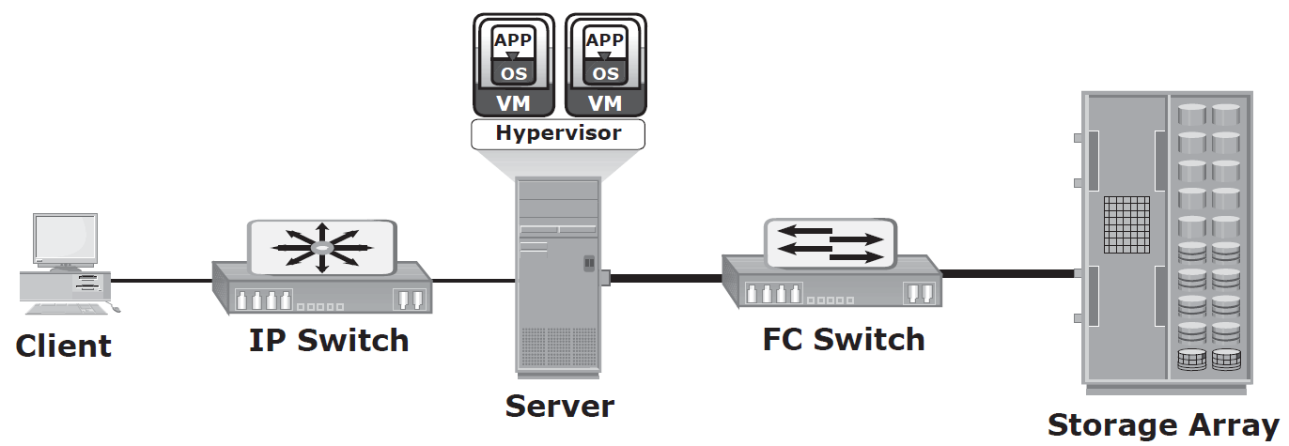
Failure Analysis
Single Point of Failure
A single point of failure refers to the failure of a component that can terminate the availability of the entire system or IT service.
Below figure depicts a system setup in which an application, running on a VM, provides an interface to the client and performs I/O operations.

Slide 44
Failure Analysis
Single Point of Failure
The client is connected to the server through an IP network, and the server is connected to the storage array through an FC connection.
In a setup in which each component must function as required to ensure data availability, the failure of a single physical or virtual component causes the unavailability of an application.
This failure results in disruption of business operations.
For example, failure of a hypervisor can affect all the running VMs and the virtual network, which are hosted on it.

Slide 45
Failure Analysis
Single Point of Failure
In the setup shown in figure (above), several single points of failure can be identified.
A VM, a hypervisor, an HBA/NIC on the server, the physical server, the IP network, the FC switch, the storage array ports, or even the storage array could be a potential single point of failure.

Slide 46
Failure Analysis
Resolving Single Points of Failure
To mitigate single points of failure, systems are designed with redundancy, such that the system fails only if all the components in the redundancy group fail.
This ensures that the failure of a single component does not affect data availability.
Data centers follow stringent guidelines to implement fault tolerance for uninterrupted information availability.

Slide 47
Failure Analysis
Resolving Single Points of Failure
Careful analysis is performed to eliminate every single point of failure.
The example shown in below Figure which represents all enhancements in the infrastructure to mitigate single points of failure

Slide 48
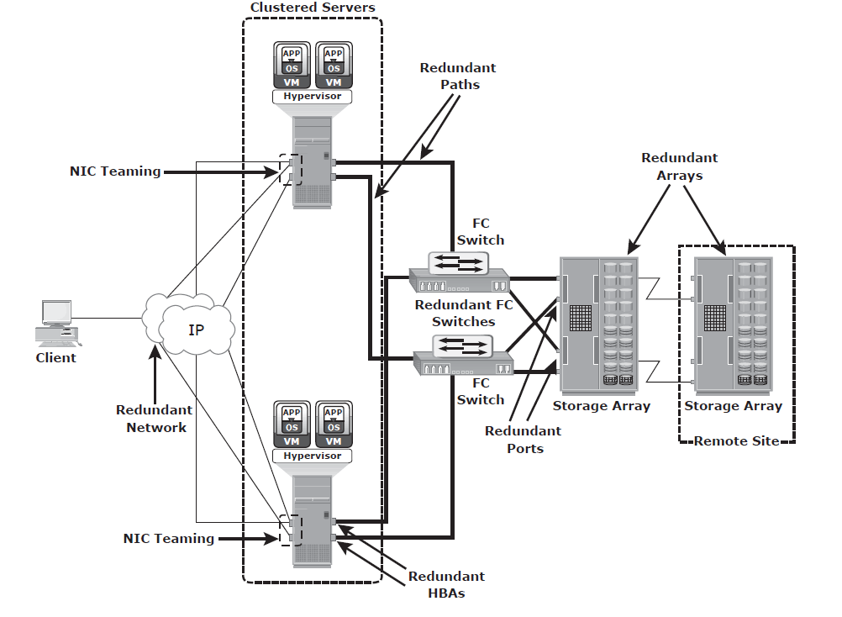
Failure Analysis
Resolving Single Points of Failure

Slide 49
Failure Analysis
Resolving Single Points of Failure
Configuration of redundant HBAs at a server to mitigate single HBA failure
Configuration of NIC teaming at a server allows protection against single physical NIC failure.
    It allows grouping of two or more physical NICs and treating them as a single logical device.
    With NIC teaming, if one of the underlying physical NICs fails or its cable is unplugged, the traffic is redirected to another physical NIC in the team.
    Thus, NIC teaming eliminates the single point of failure associated with a single physical NIC.

Slide 50
Failure Analysis
Resolving Single Points of Failure
Configuration of redundant switches to account for a switch failure
Configuration of multiple storage array ports to mitigate a port failure
RAID and hot spare configuration to ensure continuous operation in the event of disk failure
Implementation of a redundant storage array at a remote site to mitigate local site failure

Slide 51
Failure Analysis
Resolving Single Points of Failure
Implementing server (or compute) clustering, a fault-tolerance mechanism whereby two or more servers in a cluster access the same set of data volumes.
    Clustered servers exchange a heartbeat to inform each other about their health.
    If one of the servers or hypervisors fails, the other server or hypervisor can take up the workload.

Slide 52
Failure Analysis
Resolving Single Points of Failure
Implementing a VM Fault Tolerance mechanism ensures BC in the event of a server failure.
    This technique creates duplicate copies of each VM on another server so that when a VM failure is detected, the duplicate VM can be used for failover.
    The two VMs are kept in synchronization with each other in order to perform successful failover.

Slide 53
Failure Analysis
Multipathing Software
Configuration of multiple paths increases the data availability through path failover.
If servers are configured with one I/O path to the data, there will be no access to the data if that path fails.
Redundant paths to the data eliminate the possibility of the path becoming a single point of failure.
Multiple paths to data also improve I/O performance through load balancing among the paths and maximize server, storage, and data path utilization

Slide 54
Failure Analysis
Multipathing Software
In practice, merely configuring multiple paths does not serve the purpose.
Even with multiple paths, if one path fails, I/O does not reroute unless the system recognizes that it has an alternative path.
Multipathing software provides the functionality to recognize and utilize alternative I/O paths to data.
Multipathing software also manages the load balancing by distributing I/Os to all available, active paths.

Slide 55
Failure Analysis
Multipathing Software
Multipathing software intelligently manages the paths to a device by sending I/O down the optimal path based on the load balancing and failover policy setting for the device.
It also takes into account path usage and availability before deciding the path through which to send the I/O.
If a path to the device fails, it automatically reroutes the I/O to an alternative path.
In a virtual environment, multipathing is enabled either by using the hypervisor’s built-in capability or by running a third-party software module, added to the hypervisor.

Slide 56
Business Impact Analysis
A business impact analysis (BIA) identifies which business units, operations, and processes are essential to the survival of the business.
It evaluates the financial, operational, and service impacts of a disruption to essential business processes.
Selected functional areas are evaluated to determine resilience of the infrastructure to support information availability.
The BIA process leads to a report detailing the incidents and their impact over business functions.
The impact may be specified in terms of money or in terms of time.

Slide 57
Business Impact Analysis
Based on the potential impacts associated with downtime, businesses can prioritize and implement countermeasures to mitigate the likelihood of such disruptions.
These are detailed in the BC plan.
A BIA includes the following set of tasks:

Slide 58
Business Impact Analysis
A BIA includes the following set of tasks:
  Determine the business areas.
  For each business area, identify the key business processes critical to its operation.
  Determine the attributes of the business process in terms of applications, databases, and hardware and software requirements.
  Estimate the costs of failure for each business process.
  Calculate the maximum tolerable outage and define RTO and RPO for each business process.
  Establish the minimum resources required for the operation of business processes.
  Determine recovery strategies and the cost for implementing them.
  Optimize the backup and business recovery strategy based on business priorities.
  Analyze the current state of BC readiness and optimize future BC planning.

Slide 59
BC Technology Solutions
After analyzing the business impact of an outage, designing the appropriate solutions to recover from a failure is the next important activity.
One or more copies of the data are maintained using any of the following strategies so that data can be recovered or business operations can be restarted using an alternative copy.
    Backup
    Local replication
    Remote replication

Slide 60
BC Technology Solutions
Backup: Data backup is a predominant method of ensuring data availability. The frequency of backup is determined based on RPO, RTO, and the frequency of data changes.
Local replication: Data can be replicated to a separate location within the same storage array. The replica is used independently for other business operations. Replicas can also be used for restoring operations if data corruption occurs.
Remote replication: Data in a storage array can be replicated to another storage array located at a remote site. If the storage array is lost due to a disaster, business operations can be started from the remote storage array.

Slide 61
Backup and Archive
A backup is an additional copy of production data, created and retained for the sole purpose of recovering lost or corrupted data.
With growing business and regulatory demands for data storage, retention, and availability, organizations are faced with the task of backing up an ever-increasing amount of data.
This task becomes more challenging with the growth of information, stagnant IT budgets, and less time for taking backups.
Moreover, organizations need a quick restore of backed up data to meet business service-level agreements (SLAs).

Slide 62
Backup and Archive
Evaluating the various backup methods along with their recovery considerations and retention requirements is an essential step to implement a successful backup and recovery solution.
Organizations generate and maintain large volumes of data, and most of the data is fixed content. This fixed content is rarely accessed after a period of time.
Still, this data needs to be retained for several years to meet regulatory compliance.
Accumulation of this data on the primary storage increases the overall storage cost to the organization. Further, this increases the amount of data to be backed up, which in turn increases the time required to perform the backup

Slide 63
Backup and Archive
Data archiving is the process of moving data that is no longer actively used, from primary storage to a low-cost secondary storage. The data is retained in the secondary storage for a long term to meet regulatory requirements.
Moving the data from primary storage reduces the amount of data to be backed up.
This reduces the time required to back up the data.

Slide 64
Backup and Archive
Backup Purpose
Backups are performed to serve three purposes:
  Disaster recovery,
  Operational recovery, and
  Archival

Slide 65
Backup and Archive
Backup Purpose - Disaster Recovery
One purpose of backups is to address disaster recovery needs.
The backup copies are used for restoring data at an alternate site when the primary site is incapacitated due to a disaster.
Based on recovery-point objective (RPO) and recovery-time objective (RTO) requirements, organizations use different data protection strategies for disaster recovery.

Slide 66
Backup and Archive
Backup Purpose - Disaster Recovery
When tape-based backup is used as a disaster recovery option, the backup tape media is shipped and stored at an offsite location.
Later, these tapes can be recalled for restoration at the disaster recovery site.
Organizations with stringent RPO and RTO requirements use remote replication technology to replicate data to a disaster recovery site.
This allows organizations to bring production systems online in a relatively short period of time if a disaster occurs.

Slide 67
Backup and Archive
Backup Purpose - Operational Recovery
Data in the production environment changes with every business transaction and operation.
Backups are used to restore data if data loss or logical corruption occurs during routine processing.
The majority of restore requests in most organizations fall in this category.
For example, it is common for a user to accidentally delete an important e-mail or for a file to become corrupted, which can be restored using backup data.

Slide 68
Backup and Archive
Backup Purpose - Archival
Backups are also performed to address archival requirements.
Although content addressed storage (CAS) has emerged as the primary solution for archives, traditional backups are still used by small and medium enterprises for long-term preservation of transaction records, e-mail messages, and other business records required for regulatory compliance.

Slide 69
Backup and Archive
Backup Considerations
The amount of data loss and downtime that a business can endure in terms of RPO and RTO are the primary considerations in selecting and implementing a specific backup strategy. RPO refers to the point in time to which data must be recovered, and the point in time from which to restart business operations.
This specifies the time interval between two backups.
In other words, the RPO determines backup frequency.
For example, if an application requires an RPO of 1 day, it would need the data to be backed up at least once every day.

Slide 70
Backup and Archive
Backup Considerations
Another consideration is the retention period, which defines the duration for which a business needs to retain the backup copies.
Some data is retained for years and some only for a few days.
For example, data backed up for archival is retained for a longer period than data backed up for operational recovery.
The backup media type or backup target is another consideration, that is driven by RTO and impacts the data recovery time.
The time-consuming operation of starting and stopping in a tape-based system affects the backup performance, especially while backing up a large number of small files.

Slide 71
Backup and Archive
Backup Considerations
Organizations must also consider the granularity of backups, explained later in this section.
The development of a backup strategy must include a decision about the most appropriate time for performing a backup to minimize any disruption to production operations.
The location, size, number of files, and data compression should also be considered because they might affect the backup process.
Location is an important consideration for the data to be backed up.

Slide 72
Backup and Archive
Backup Considerations
Many organizations have dozens of heterogeneous platforms locally and remotely supporting their business. Consider a data warehouse environment that uses the backup data from many sources.
The backup process must address these sources for transactional and content integrity.
This process must be coordinated with all heterogeneous platforms at all locations on which the data resides.

Slide 73
Backup and Archive
Backup Considerations
The file size and number of files also influence the backup process.
Backing up large-size files (for example, ten 1 MB files) takes less time, compared to backing up an equal amount of data composed of small-size files (for example, ten thousand 1 KB files).
Data compression and data deduplication are widely used in the backup environment because these technologies save space on the media.
Many backup devices have built-in support for hardware-based data compression. Some data, such as application binaries, do not compress well, whereas text data does compress well.

Slide 74
Backup and Archive
Backup Granularity
Backup granularity depends on business needs and the required RTO/RPO.
Based on the granularity, backups can be categorized as full, incremental and accumulative (differential).
Most organizations use a combination of these three backup types to meet their backup and recovery requirements.
Below figure shows the different backup granularity levels.

Slide 75
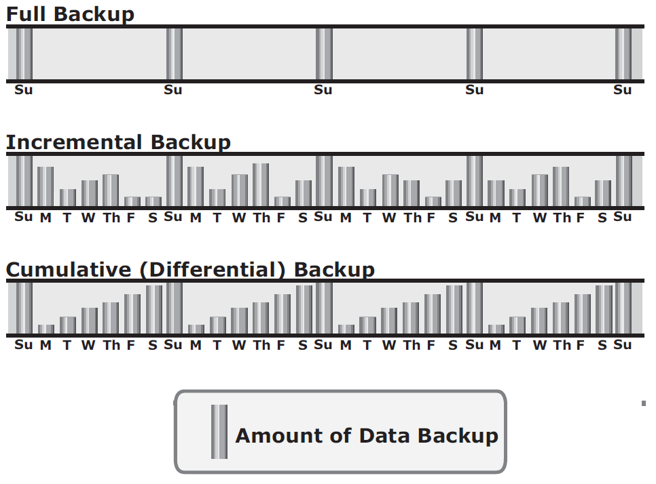
Backup and Archive
Backup Granularity
Backup granularity levels

Slide 76
Backup and Archive
Backup Granularity
Full backup is a backup of the complete data on the production volumes.
A full backup copy is created by copying the data in the production volumes to a backup storage device.
It provides a faster recovery but requires more storage space and also takes more time to back up.
Incremental backup copies the data that has changed since the last full or incremental backup, whichever has occurred more recently.

Slide 77
Backup and Archive
Backup Granularity
This is much faster than a full backup (because the volume of data backed up is restricted to the changed data only) but takes longer to restore.
Cumulative backup copies the data that has changed since the last full backup.
This method takes longer than an incremental backup but is faster to restore.

Slide 78
Backup and Archive
Backup Granularity
Restore operations vary with the granularity of the backup.
A full backup provides a single repository from which the data can be easily restored.
The process of restoration from an incremental backup requires the last full backup and all the incremental backups available until the point of restoration.
A restore from a cumulative backup requires the last full backup and the most recent cumulative backup.

Slide 79
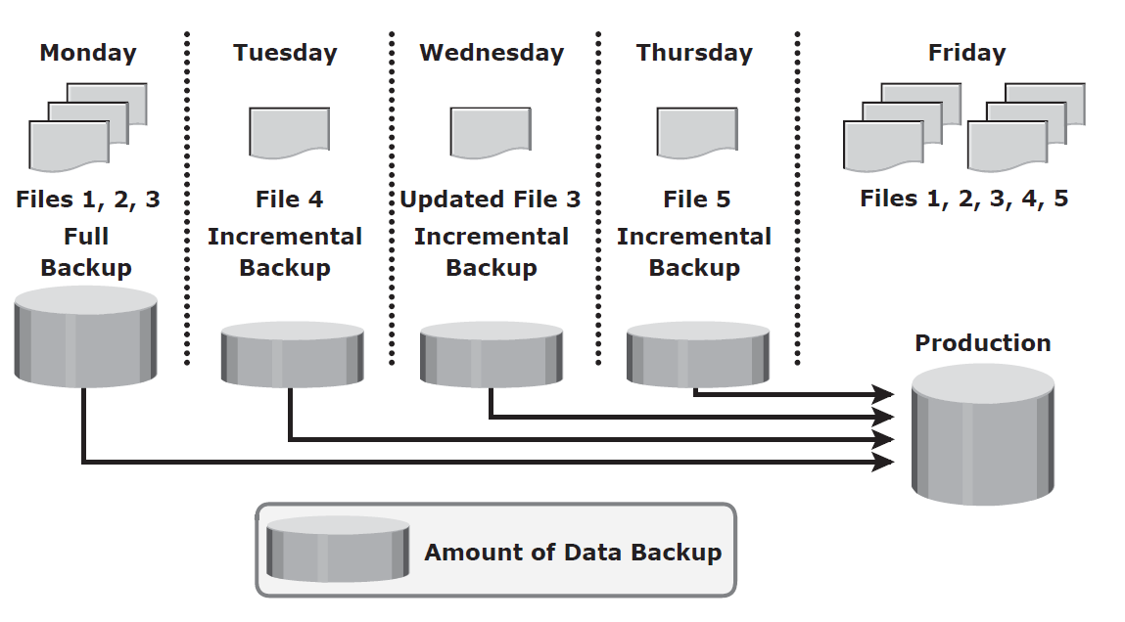
Backup and Archive
Backup Granularity - Restoring from an incremental backup

Slide 80
Backup and Archive
Backup Granularity - Restoring from an incremental backup
In this example, a full backup is performed on Monday evening.
Each day after that, an incremental backup is performed. On Tuesday, a new file (File 4 in the figure) is added, and no other files have changed. Consequently, only File 4 is copied during the incremental backup performed on Tuesday evening.
On Wednesday, no new files are added, but File 3 has been modified.
Therefore, only the modified File 3 is copied during the incremental backup on Wednesday evening.

Slide 81
Backup and Archive
Backup Granularity - Restoring from an incremental backup
Similarly, the incremental backup on Thursday copies only File 5.
On Friday morning, there is data corruption, which requires data restoration from the backup.
The first step toward data restoration is restoring all data from the full backup of Monday evening.
The next step is applying the incremental backups of Tuesday, Wednesday, and Thursday.
In this manner, data can be successfully recovered to its previous state, as it existed on Thursday evening.

Slide 82
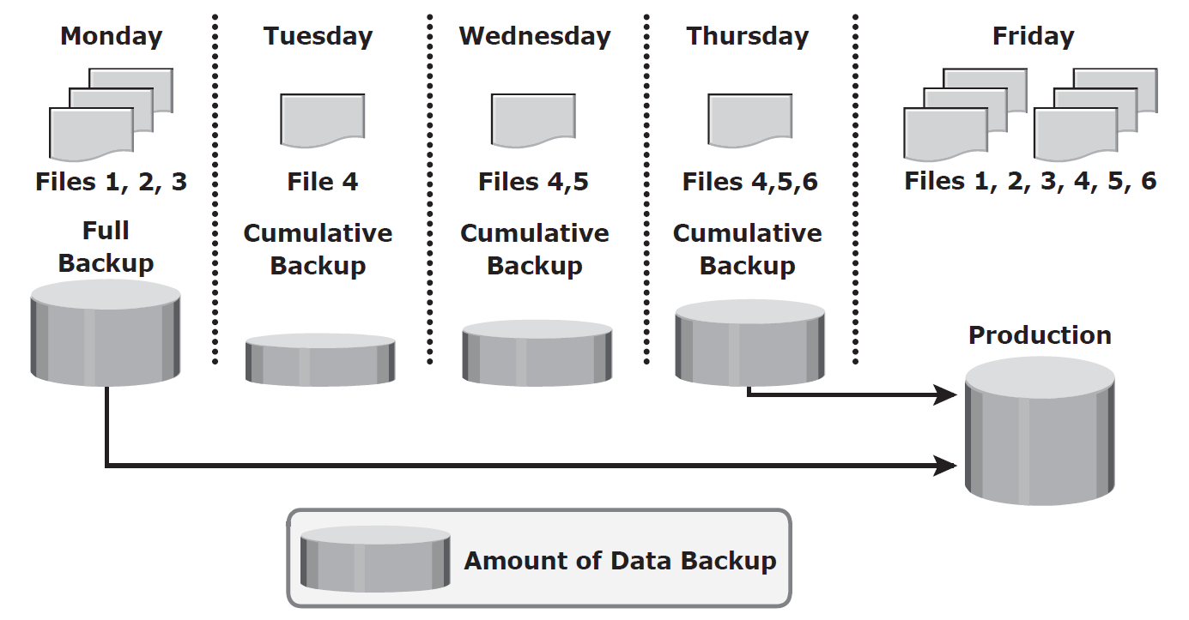
Backup and Archive
Backup Granularity - Restoring from an cumulative backup

Slide 83
Backup and Archive
Backup Granularity - Restoring from an cumulative backup
In this example, a full backup of the business data is taken on Monday evening.
Each day after that, a cumulative backup is taken. On Tuesday, File 4 is added and no other data is modified since the previous full backup of Monday evening.
Consequently, the cumulative backup on Tuesday evening copies only File 4.
On Wednesday, File 5 is added.
The cumulative backup taking place on Wednesday evening copies both File 4 and File 5 because these files have been added or modified since the last full backup.

Slide 84
Backup and Archive
Backup Granularity - Restoring from an cumulative backup
Similarly, on Thursday, File 6 is added.
Therefore, the cumulative backup on Thursday evening copies all three files: File 4, File 5, and File 6.
On Friday morning, data corruption occurs that requires data restoration using backup copies.
The first step in restoring data is to restore all the data from the full backup of Monday evening.

Slide 85
Backup and Archive
Backup Granularity - Restoring from an cumulative backup
The next step is to apply only the latest cumulative backup, which is taken on Thursday evening.
In this way, the production data can be recovered faster because its needs only two copies of data — the last full backup and the latest cumulative backup

Slide 86
Backup and Archive
Recovery Considerations
The retention period is a key consideration for recovery.
The retention period for a backup is derived from an RPO.
For example, users of an application might request to restore the application data from its backup copy, which was created a month ago. This determines the retention period for the backup.
Therefore, the minimum retention period of this application data is one month.

Slide 87
Backup and Archive
Recovery Considerations
However, the organization might choose to retain the backup for a longer period of time because of internal policies or external factors, such as regulatory directives.
If the recovery point is older than the retention period, it might not be possible to recover all the data required for the requested recovery point.
Long retention periods can be defined for all backups, making it possible to meet any RPO within the defi ned retention periods.
However, this requires a large storage space, which translates into higher cost.

Slide 88
Backup and Archive
Recovery Considerations
Therefore, while defining the retention period, analyze all the restore requests in the past and the allocated budget.
RTO relates to the time taken by the recovery process.
To meet the defined RTO, the business may choose the appropriate backup granularity to minimize recovery time.
In a backup environment, RTO influences the type of backup media that should be used.
For example, a restore from tapes takes longer to complete than a restore from disks.

Slide 89
Backup and Archive
Backup Methods
Hot backup and cold backup are the two methods deployed for a backup.
They are based on the state of the application when the backup is performed.
In a hot backup, the application is up-and-running, with users accessing their data during the backup process.
This method of backup is also referred to as an online backup.
A cold backup requires the application to be shut down during the backup process.
Hence, this method is also referred to as an offline backup.

Slide 90
Backup and Archive
Backup Methods
The hot backup of online production data is challenging because data is actively used and changed.
If a file is open, it is normally not backed up during the backup process.
In such situations, an open file agent is required to backup the open file.
These agents interact directly with the operating system or application and enable the creation of consistent copies of open files.

Slide 91
Backup and Archive
Backup Methods
In database environments, the use of open file agents is not enough, because the agent should also support a consistent backup of all the database components.
For example, a database is composed of many files of varying sizes occupying several file systems.
To ensure a consistent database backup, all files need to be backed up in the same state.
That does not necessarily mean that all files need to be backed up at the same time, but they all must be synchronized so that the database can be restored with consistency.

Slide 92
Backup and Archive
Backup Methods
The disadvantage associated with a hot backup is that the agents usually affect the overall application performance.
Consistent backups of databases can also be done by using a cold backup.
This requires the database to remain inactive during the backup.
Of course, the disadvantage of a cold backup is that the database is inaccessible to users during the backup process.

Slide 93
Backup and Archive
Backup Methods
A point-in-time (PIT) copy method is deployed in environments in which the impact of downtime from a cold backup or the performance impact resulting from a hot backup is unacceptable.
The PIT copy is created from the production volume and used as the source for the backup.
This reduces the impact on the production volume.
To ensure consistency, it is not enough to back up only the production data for recovery. Certain attributes and properties attached to a file, such as permissions, owner, and other metadata, also need to be backed up.
These attributes are as important as the data itself and must be backed up for consistency.

Slide 94
Backup and Archive
Backup Methods
In a disaster recovery environment, bare-metal recovery (BMR) refers to a backup in which all metadata, system information, and application configurations are appropriately backed up for a full system recovery.
BMR builds the base system, which includes partitioning, the fi le system layout, the operating system, the applications, and all the relevant configurations. BMR recovers the base system first before starting the recovery of data files.
Some BMR technologies - for example server configuration backup (SCB) - can recover a server even onto dissimilar hardware.

Slide 95
Backup and Archive
Backup Architecture
A backup system commonly uses the client-server architecture with a backup server and multiple backup clients.
The backup server manages the backup operations and maintains the backup catalog, which contains information about the backup configuration and backup metadata.
Backup configuration contains information about when to run backups, which client data to be backed up, and so on, and the backup metadata contains information about the backed up data.
The role of a backup client is to gather the data that is to be backed up and send it to the storage node.
It also sends the tracking information to the backup server.

Slide 96
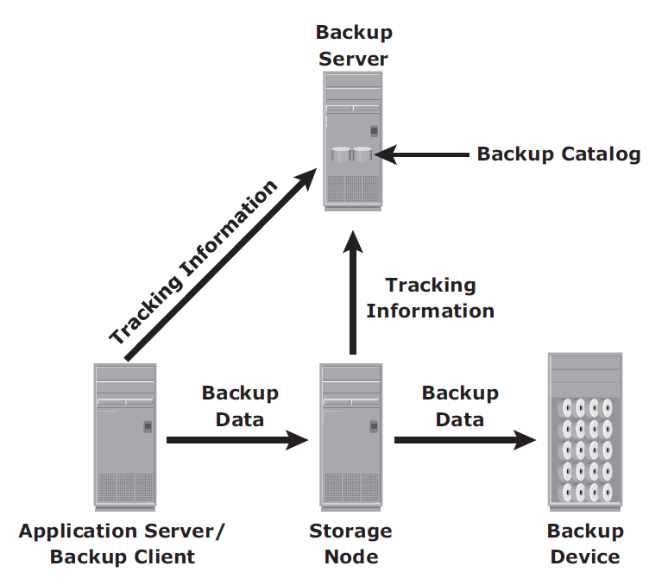
Backup and Archive
Backup Architecture

Slide 97
Backup and Archive
Backup Architecture
The storage node is responsible for writing the data to the backup device. (In a backup environment, a storage node is a host that controls backup devices.)
The storage node also sends tracking information to the backup server.
In many cases, the storage node is integrated with the backup server, and both are hosted on the same physical platform.
A backup device is attached directly or through a network to the storage node’s host platform.
Some backup architecture refers to the storage node as the media server because it manages the storage device.

Slide 98
Backup and Archive
Backup Architecture
Backup software provides reporting capabilities based on the backup catalog and the log files.
These reports include information, such as the amount of data backed up, the number of completed and incomplete backups, and the types of errors that might have occurred.
Reports can be customized depending on the specific backup software used.

Slide 99
Backup and Archive
Backup and Restore Operations
When a backup operation is initiated, significant network communication takes place between the different components of a backup infrastructure.
The backup operation is typically initiated by a server, but it can also be initiated by a client.
The backup server initiates the backup process for different clients based on the backup schedule configured for them.
For example, the backup for a group of clients may be scheduled to start at 11:00 p.m. every day.

Slide 100
Backup and Archive
Backup and Restore Operations
The backup server coordinates the backup process with all the components in a backup environment.
The backup server maintains the information about backup clients to be backed up and storage nodes to be used in a backup operation.
The backup server retrieves the backup-related information from the backup catalog and, based on this information, instructs the storage node to load the appropriate backup media into the backup devices.
Simultaneously, it instructs the backup clients to gather the data to be backed up and send it over the network to the assigned storage node.
After the backup data is sent to the storage node, the client sends some backup metadata (the number of files, name of the fi les, storage node details, and so on) to the backup server.

Slide 101
Backup and Archive
Backup and Restore Operations
The storage node receives the client data, organizes it, and sends it to the backup device.
The storage node then sends additional backup metadata (location of the data on the backup device, time of backup, and so on) to the backup server.
The backup server updates the backup catalog with this information.

Slide 102
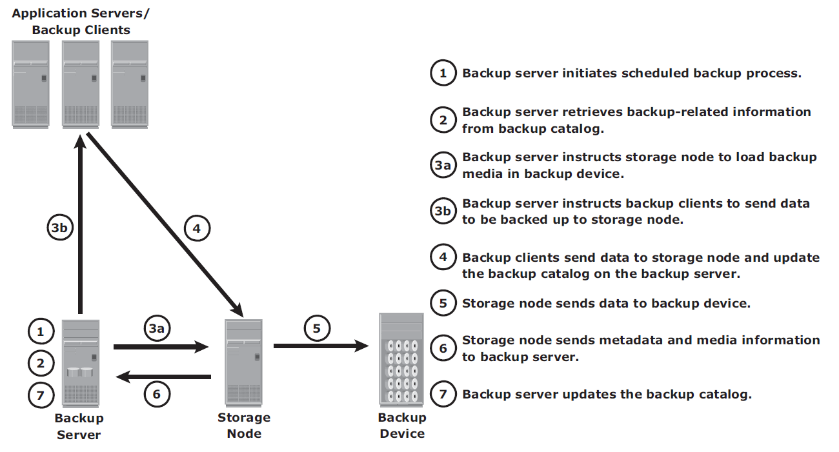
Backup and Archive
Backup and Restore Operations
Backup operation

Slide 103
Backup and Archive
Backup and Restore Operations
After the data is backed up, it can be restored when required.
A restore process must be manually initiated from the client.
Some backup software has a separate application for restore operations.
These restore applications are usually accessible only to the administrators or backup operators.

Slide 104
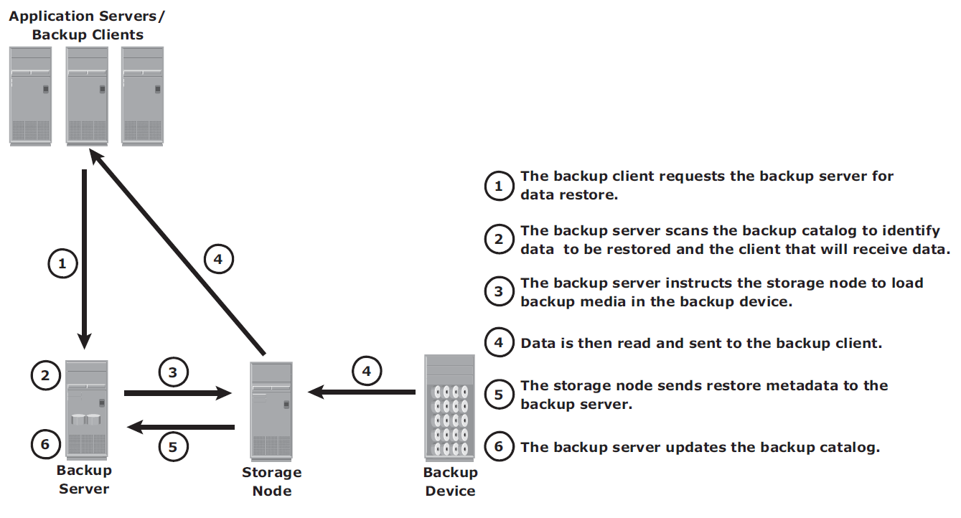
Backup and Archive
Backup and Restore Operations
Restore Operation

Slide 105
Backup and Archive
Backup and Restore Operations
Upon receiving a restore request, an administrator opens the restore application to view the list of clients that have been backed up.
While selecting the client for which a restore request has been made, the administrator also needs to identify the client that will receive the restored data.
Data can be restored on the same client for whom the restore request has been made or on any other client.
The administrator then selects the data to be restored and the specified point in time to which the data has to be restored based on the RPO.
Because all this information comes from the backup catalog, the restore application needs to communicate with the backup server

Slide 106
Backup and Archive
Backup Topologies
Three basic topologies are used in a backup environment:
  Direct-attached backup,
  LAN-based backup, and
  SAN-based backup.
A mixed topology is also used by combining LAN-based and SAN-based topologies.

Slide 107
Backup and Archive
Backup and Restore Operations
Direct-attached backup
In a direct-attached backup, the storage node is configured on a backup client, and the backup device is attached directly to the client.
Only the metadata is sent to the backup server through the LAN.
This configuration frees the LAN from backup traffic.
As the environment grows, there will be a need for centralized management and sharing of backup devices to optimize costs.
An appropriate solution is required to share the backup devices among multiple servers.
Network-based topologies (LAN-based and SAN-based) provide the solution to optimize the utilization of backup devices.

Slide 108
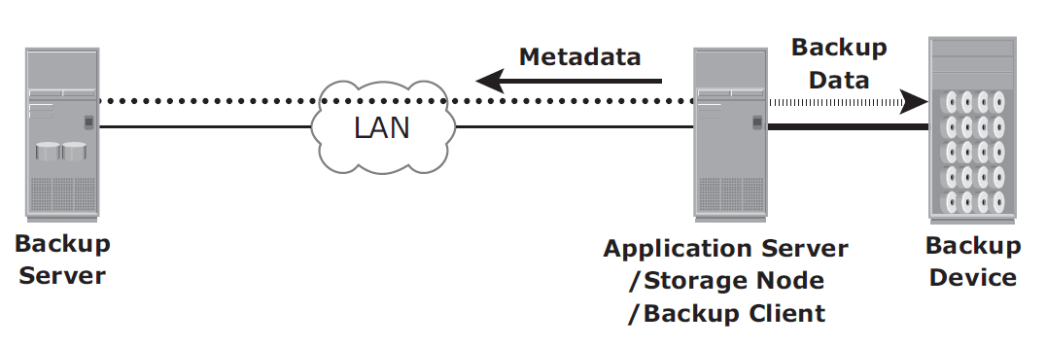
Backup and Archive
Backup and Restore Operations
Direct-attached backup
The example in the Figure shows that the backup device is directly attached and dedicated to the backup client.

Slide 109
Backup and Archive
Backup and Restore Operations
LAN-based backup
In a LAN-based backup, the clients, backup server, storage node, and backup device are connected to the LAN.
The data to be backed up is transferred from the backup client (source) to the backup device (destination) over the LAN, which might affect network performance.
This impact can be minimized by adopting a number of measures, such as configuring separate networks for backup and installing dedicated storage nodes for some application servers.

Slide 110
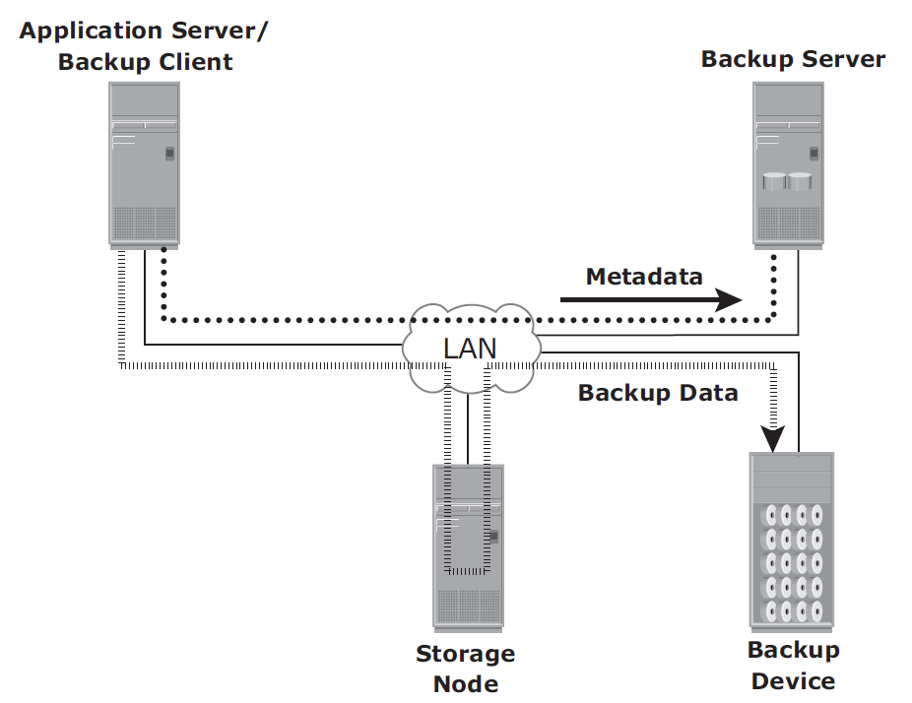
Backup and Archive
Backup and Restore Operations
LAN-based backup
LAN-based backup topology

Slide 111
Backup and Archive
Backup and Restore Operations
SAN-based backup
A SAN-based backup is also known as a LAN-free backup.
The SAN-based backup topology is the most appropriate solution when a backup device needs to be shared among clients.
In this case, the backup device and clients are attached to the SAN.

Slide 112
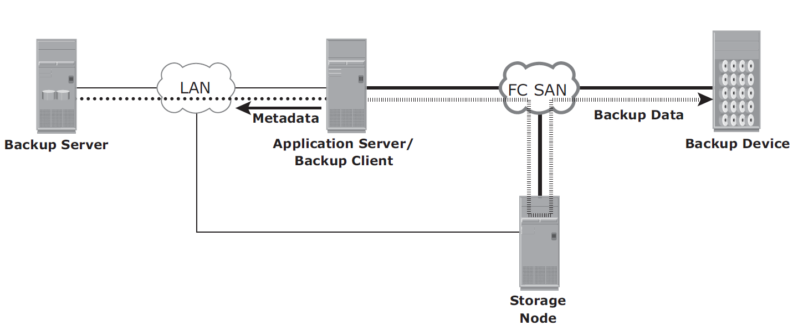
Backup and Archive
Backup and Restore Operations
SAN-based backup
SAN-based backup

Slide 113
Backup and Archive
Backup and Restore Operations
SAN-based backup
In this example, a client sends the data to be backed up to the backup device over the SAN.
Therefore, the backup data traffic is restricted to the SAN, and only the backup metadata is transported over the LAN.
The volume of metadata is insignificant when compared to the production data; the LAN performance is not degraded in this configuration.
The emergence of low-cost disks as a backup medium has enabled disk arrays to be attached to the SAN and used as backup devices.
A tape backup of these data backups on the disks can be created and shipped offsite for disaster recovery and long-term retention.

Slide 114
Backup and Archive
Backup and Restore Operations
Mixed topology
The mixed topology uses both the LAN-based and SAN-based topologies.
This topology might be implemented for several reasons, including cost, server location, reduction in administrative overhead, and performance considerations.

Slide 115
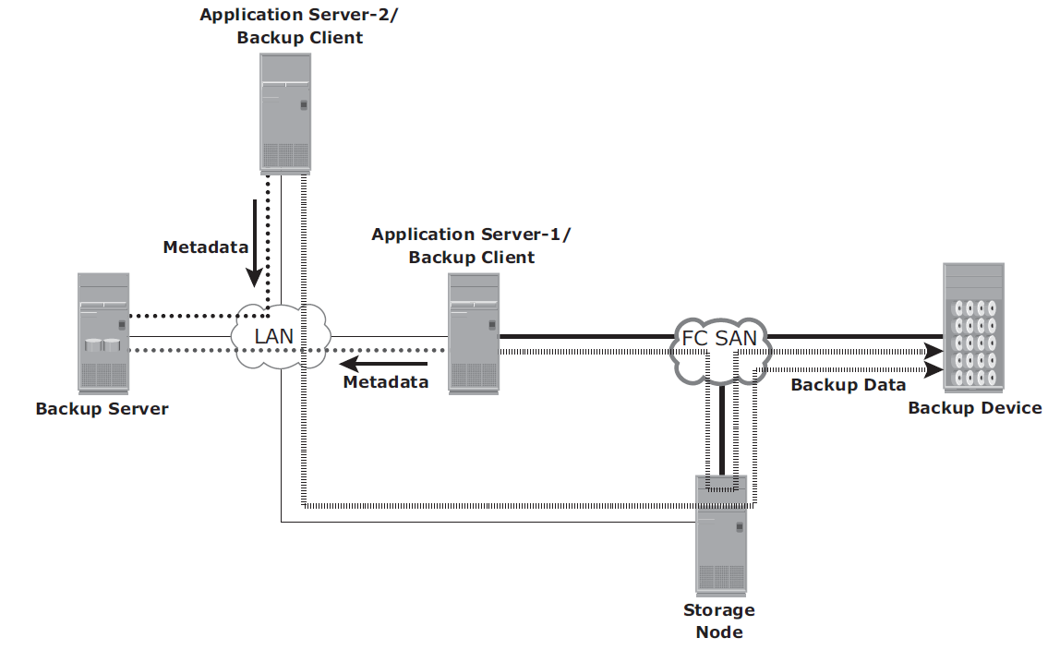
Backup and Archive
Backup and Restore Operations
Mixed topology
Mixed backup topology

Slide 116
Backup and Archive
Backup in NAS Environments
The use of a NAS head imposes a new set of considerations on the backup and recovery strategy in NAS environments.
NAS heads use a proprietary operating system and file system structure that supports multiple file-sharing protocols.
In the NAS environment, backups can be implemented in different ways:
  Server based,
  serverless, or
  using Network Data Management Protocol (NDMP).
Common implementations are NDMP 2-way and NDMP 3-way.

Slide 117
Backup and Archive
Backup in NAS Environments
Server-Based
In an application server-based backup, the NAS head retrieves data from a storage array over the network and transfers it to the backup client running on the application server.
The backup client sends this data to the storage node, which in turn writes the data to the backup device.
This results in overloading the network with the backup data and using application server resources to move the backup data

Slide 118
Backup and Archive
Backup in NAS Environments
Server-Based Backup
Server-based backup in the NAS environment

Slide 119
Backup and Archive
Backup in NAS Environments
Serverless Backup
In a serverless backup, the network share is mounted directly on the storage node.
This avoids overloading the network during the backup process and eliminates the need to use resources on the application server.
In this scenario, the storage node, which is also a backup client, reads the data from the NAS head and writes it to the backup device without involving the application server.
Compared to the previous solution, this eliminates one network hop.

Slide 120
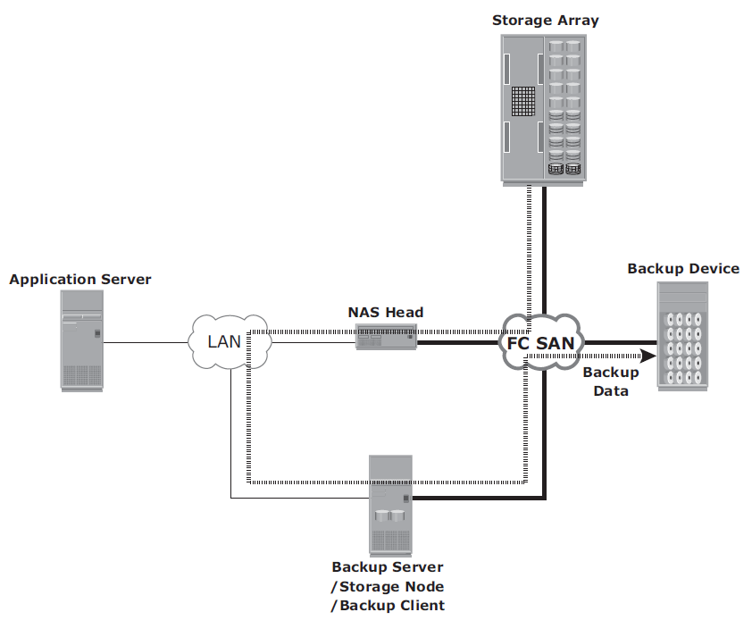
Backup and Archive
Backup in NAS Environments
Serverless Backup
Serverless backup in a NAS environment

Slide 121
Backup and Archive
Backup in NAS Environments
NDMP-Based Backup
NDMP is an industry-standard TCP/IP-based protocol specifically designed for a backup in a NAS environment.
It communicates with several elements in the backup environment (NAS head, backup devices, backup server, and so on) for data transfer and enables vendors to use a common protocol for the backup architecture.
Data can be backed up using NDMP regardless of the operating system or platform. Due to its flexibility, it is no longer necessary to transport data through the application server, which reduces the load on the application server and improves the backup speed.

Slide 122
Backup and Archive
Backup in NAS Environments
NDMP-Based Backup
NDMP optimizes backup and restore by leveraging the high-speed connection between the backup devices and the NAS head.
In NDMP, backup data is sent directly from the NAS head to the backup device, whereas metadata is sent to the backup server.
In this model, network traffic is minimized by isolating data movement from the NAS head to the locally attached backup device.
Only metadata is transported on the network.
The backup device is dedicated to the NAS device, and hence, this method does not support centralized management of all backup devices.

Slide 123
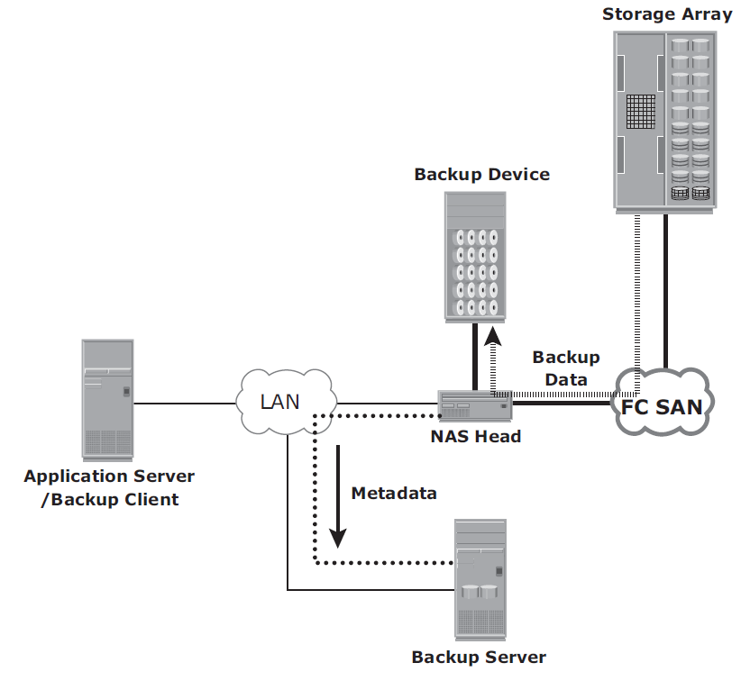
Backup and Archive
Backup in NAS Environments
NDMP-Based Backup
NDMP 2-way in a NAS environment

Slide 124
Backup and Archive
Backup in NAS Environments
NDMP-Based Backup
In the NDMP 3-way method, a separate private backup network must be established between all NAS heads and the NAS head connected to the backup device.
Metadata and NDMP control data are still transferred across the public network.
An NDMP 3-way is useful when backup devices need to be shared among NAS heads.
It enables the NAS head to control the backup device and share it with other NAS heads by receiving the backup data through the NDMP.

Slide 125
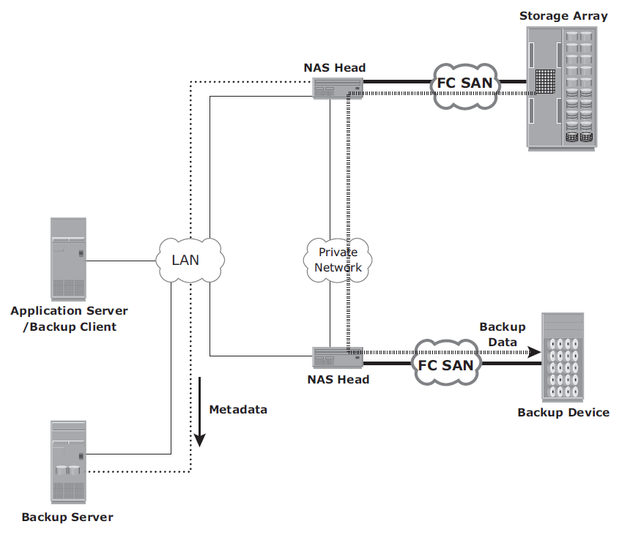
Backup and Archive
Backup in NAS Environments
NDMP-Based Backup
NDMP 3-way in a NAS environment

Slide 126
Backup and Archive
Backup Targets
A wide range of technology solutions are currently available for backup targets.
Tape and disk libraries are the two most commonly used backup targets.
In the past, tape technology was the predominant target for backup due to its low cost.
But performance and management limitations associated with tapes and the availability of low-cost disk drives have made the disk a viable backup target.
A virtual tape library (VTL) is one of the options that uses disks as a backup medium.
VTL emulates tapes and provides enhanced backup and recovery capabilities.

Slide 127
Backup and Archive
Backup Targets
Backup to Tape
Tapes, a low-cost solution, are used extensively for backup.
Tape drives are used to read/write data from/to a tape cartridge (or cassette).
Tape drives are referred to as sequential, or linear, access devices because the data is written or read sequentially.
A tape cartridge is composed of magnetic tapes in a plastic enclosure.
Tape mounting is the process of inserting a tape cartridge into a tape drive.
The tape drive has motorized controls to move the magnetic tape around, enabling the head to read or write data.
Several types of tape cartridges are available.
They vary in size, capacity, shape, density, tape length, tape thickness, tape tracks, and supported speed.

Slide 128
Backup and Archive
Backup Targets
Backup to Tape - Physical Tape Library
The physical tape library provides housing and power for a large number of tape drives and tape cartridges, along with a robotic arm or picker mechanism.
The backup software has intelligence to manage the robotic arm and entire backup process.
Below figure shows a physical tape library.

Slide 129
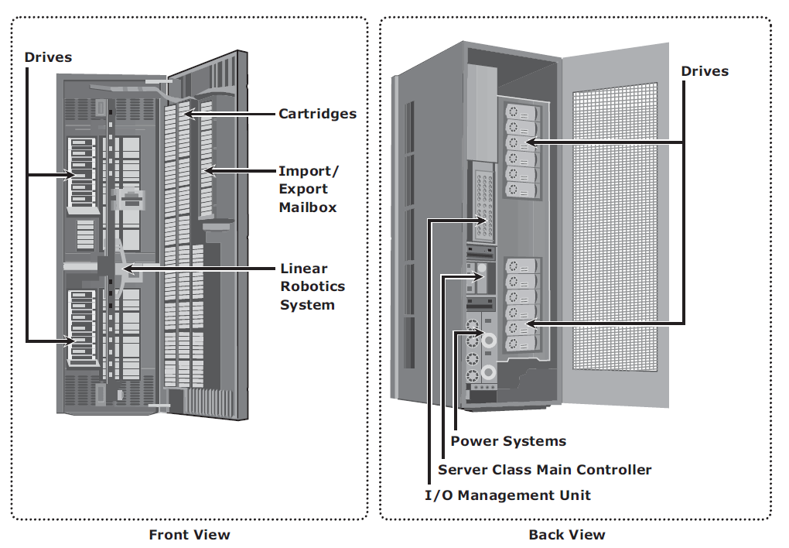
Backup and Archive
Backup Targets
Physical Tape Library

Slide 130
Backup and Archive
Backup Targets
Backup to Tape - Physical Tape Library
Tape drives read and write data from and to a tape.
Tape cartridges are placed in the slots when not in use by a tape drive.
Robotic arms are used to move tapes between cartridge slots and tape drives.
Mail or import/export slots are used to add or remove tapes from the library without opening the access doors
When a backup process starts, the robotic arm is instructed to load a tape to a tape drive.
This process adds delay to a degree depending on the type of hardware used, but it generally takes 5 to 10 seconds to mount a tape.

Slide 131
Backup and Archive
Backup Targets
Backup to Tape - Physical Tape Library
After the tape is mounted, additional time is spent to position the heads and validate header information.
This total time is called load to ready time, and it can vary from several seconds to minutes.
The tape drive receives backup data and stores the data in its internal buffer.
This backup data is then written to the tape in blocks.
During this process, it is best to ensure that the tape drive is kept busy continuously to prevent gaps between the blocks.
This is accomplished by buffering the data on tape drives.
The speed of the tape drives can also be adjusted to match data transfer rates.

Slide 132
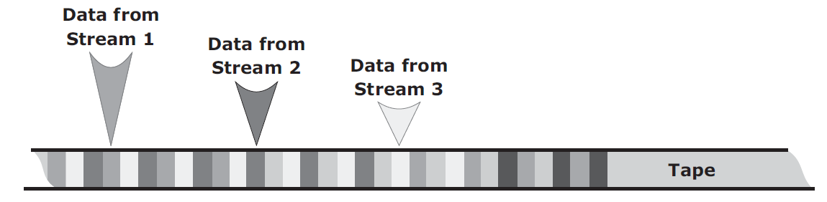
Backup and Archive
Backup Targets
Backup to Tape - Physical Tape Library
Tape drive streaming or multiple streaming writes data from multiple streams on a single tape to keep the drive busy.
As shown in below figure, multiple streaming improves media performance, but it has an associated disadvantage. (Fig. Multiple streams on tape media)
The backup data is interleaved because data from multiple streams is written on it.
Consequently, the data recovery time is increased because all the extra data from the other streams must be read and discarded while recovering a single stream.

Slide 133
Backup and Archive
Backup Targets
Backup to Tape - Physical Tape Library
Tape drive streaming or multiple streaming writes data from multiple streams on a single tape to keep the drive busy.
As shown in below figure, multiple streaming improves media performance, but it has an associated disadvantage. (Fig. Multiple streams on tape media)
The backup data is interleaved because data from multiple streams is written on it.
Consequently, the data recovery time is increased because all the extra data from the other streams must be read and discarded while recovering a single stream.

Slide 134
Backup and Archive
Backup Targets
Backup to Tape - Physical Tape Library
Many times, even the buffering and speed adjustment features of a tape drive fail to prevent the gaps, causing the “shoe shining effect” or “backhitching.”
Shoe shining is the repeated back and forth motion a tape drive makes when there is an interruption in the backup data stream.
For example, if a storage node sends data slower than the tape drive writes it to the tape, the drive periodically stops and waits for the data to catch up.
After the drive determines that there is enough data to start writing again, it rewinds to the exact place where the last write took place and continues.
This repeated back-and-forth motion not only causes a degradation of service, but also excessive wear and tear to tapes.

Slide 135
Backup and Archive
Backup Targets
Backup to Tape - Physical Tape Library
When the tape operation finishes, the tape rewinds to the starting position and it is unmounted.
The robotic arm is then instructed to move the unmounted tape back to the slot.
Rewind time can range from several seconds to minutes.
When a restore is initiated, the backup software identifies which tapes are required.
The robotic arm is instructed to move the tape from its slot to a tape drive.
If the required tape is not found in the tape library, the backup software displays a message, instructing the operator to manually insert the required tape in the tape library.

Slide 136
Backup and Archive
Backup Targets
Backup to Tape - Physical Tape Library
When a file or a group of files require restores, the tape must move to that file location sequentially before it can start reading.
This process can take a significant amount of time, especially if the required files are recorded at the end of the tape.
Modern tape devices have an indexing mechanism that enables a tape to be fast forwarded to a location near the required data.
The tape drive then finetunes the tape position to get to the data.
However, before adopting a solution that uses this mechanism, one should consider the benefits of data streaming performance versus the cost of writing an index.

Slide 137
Backup and Archive
Backup Targets
Backup to Tape - Physical Tape Library
Limitations of Tape
Tapes are primarily used for long-term offsite storage because of their low cost.
Tapes must be stored in locations with a controlled environment to ensure preservation of the media and to prevent data corruption.
Data access in a tape is sequential, which can slow backup and recovery operations.
Tapes are highly susceptible to wear and tear and usually have shorter shelf life.
Physical transportation of the tapes to offsite locations also adds to management overhead and increases the possibility of loss of tapes during offsite shipment.

Slide 138
Backup and Archive
Backup Targets
Backup to Disk
Because of increased availability, low cost disks have now replaced tapes as the primary device for storing backup data because of their performance advantages.
Backup-to-disk systems offer ease of implementation, reduced TCO, and improved quality of service.
Apart from performance benefits in terms of data transfer rates, disks also offer faster recovery when compared to tapes.
Backing up to disk storage systems offers clear advantages due to their inherent random access and RAID-protection capabilities.
In most backup environments, backup to disk is used as a staging area where the data is copied temporarily before transferring or staging it to tapes.
This enhances backup performance.

Slide 139
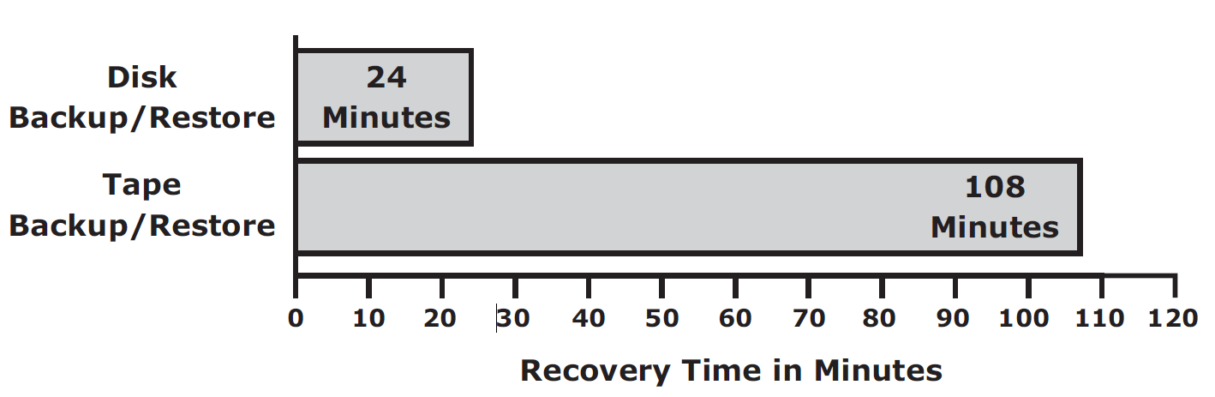
Backup and Archive
Backup Targets
Backup to Disk
Some backup products allow for backup images to remain on the disk for a period of time even after they have been staged.
This enables a much faster restore.
Below figure illustrates a recovery scenario comparing tape versus disk in a Microsoft Exchange environment that supports 800 users with a 75 MB mailbox size and a 60 GB database.
Tape versus disk restore

Slide 140
Backup and Archive
Backup Targets
Backup to Disk
As shown in the figure, a restore from the disk took 24 minutes compared to the restore from a tape, which took 108 minutes for the same environment.
Recovering from a full backup copy stored on disk and kept onsite provides the fastest recovery solution.
Using a disk enables the creation of full backups more frequently, which in turn improves RPO and RTO.
Backup to disk does not offer any inherent offsite capability and is dependent on other technologies, such as local and remote replication.
In addition, some backup products require additional modules and licenses to support backup to disk, which may also require additional configuration steps, including creation of RAID groups and file system tuning.
These activities are not usually performed by a backup administrator

Slide 141
Backup and Archive
Backup Targets
Backup to Virtual Tape
Virtual tapes are disk drives emulated and presented as tapes to the backup software.
The key benefit of using a virtual tape is that it does not require any additional modules, configuration, or changes in the legacy backup software.
This preserves the investment made in the backup software.
Virtual Tape Library
A virtual tape library (VTL) has the same components as that of a physical tape library, except that the majority of the components are presented as virtual resources.
For the backup software, there is no difference between a physical tape library and a virtual tape library.

Slide 142
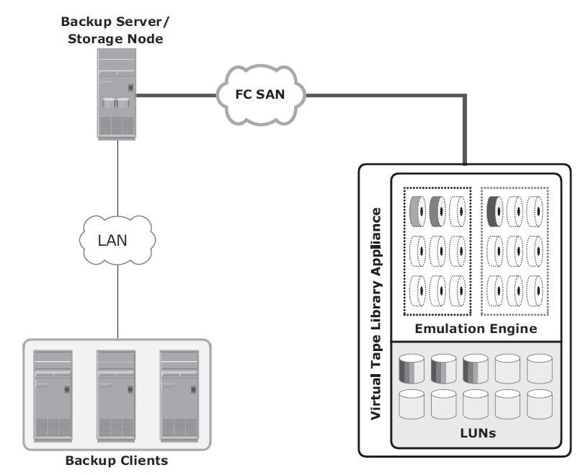
Backup and Archive
Backup Targets
Backup to Virtual Tape
Virtual Tape Library

Slide 143
Backup and Archive
Backup Targets
Backup to Virtual Tape
Virtual tape libraries use disks as backup media. Emulation software has a database with a list of virtual tapes, and each virtual tape is assigned space on a LUN.
A virtual tape can span multiple LUNs if required.
File system awareness is not required while backing up because the virtual tape solution typically uses raw devices.
Similar to a physical tape library, a robot mount is virtually performed when a backup process starts in a virtual tape library.
However, unlike a physical tape library, where this process involves some mechanical delays, in a virtual tape library it is almost instantaneous.

Slide 144
Backup and Archive
Backup Targets
Backup to Virtual Tape
Even the load to ready time is much less than in a physical tape library.
After the virtual tape is mounted and the virtual tape drive is positioned, the virtual tape is ready to be used, and backup data can be written to it.
In most cases, data is written to the virtual tape immediately.
Unlike a physical tape library, the virtual tape library is not constrained by the sequential access
and shoe shining effect.
When the operation is complete, the backup software issues a rewind command.
This rewind is also instantaneous.
The virtual tape is then unmounted, and the virtual robotic arm is instructed to move it back to a virtual slot.

Slide 145
Backup and Archive
Backup Targets
Backup to Virtual Tape
The steps to restore data are similar to those in a physical tape library, but the restore operation is nearly instantaneous.
Even though virtual tapes are based on disks, which provide random access, they still emulate the tape behavior.
A virtual tape library appliance offers a number of features that are not available with physical tape libraries.
Some virtual tape libraries offer multiple emulation engines configured in an active cluster configuration.
An engine is a dedicated server with a customized operating system that makes physical disks in the VTL appear as tapes to the backup application.
With this feature, one engine can pick up the virtual resources from another engine in the event of any failure and enable the clients to continue using their assigned virtual resources transparently.

Slide 146
Backup and Archive
Backup Targets
Backup to Virtual Tape
Data replication over IP is available with most of the virtual tape library appliances.
This feature enables virtual tapes to be replicated over an inexpensive IP network to a remote site.
As a result, organizations can comply with offsite requirements for backup data.
Connecting the engines of a virtual tape library appliance to a physical tape library enables the virtual tapes to be copied onto the physical tapes, which can then be sent to a vault or shipped to an offsite location.

Slide 147
Backup and Archive
Backup Targets
Backup to Virtual Tape
Using virtual tapes offers several advantages over both physical tapes and disks.
Compared to physical tapes, virtual tapes offer better single stream performance, better reliability, and random disk access characteristics.
Backup and restore operations benefit from the disk’s random access characteristics because they are always online and provide faster backup and recovery.
A virtual tape drive does not require the usual maintenance tasks associated with a physical tape drive, such as periodic cleaning and drive calibration.
Compared to backup-to-disk devices, a virtual tape library offers easy installation and administration because it is preconfigured by the manufacturer.
However, a virtual tape library is generally used only for backup purposes.
In a backup-to-disk environment, the disk systems are used for both production and backup data.

Slide 148
Backup and Archive
Backup Targets
Backup Targets Comparison
FEATURES | TAPE | DISK | VIRTUAL TAPE
Offsite Replication Capabilities | No | Yes | Yes
Reliability | No inherent protection methods | Yes | Yes
Performance | Subject to mechanical operations, loading time | Faster single stream | Faster single stream
Use | Backup only | Multiple (backup, production) | Backup only

Slide 149
Backup and Archive
Data Deduplication for Backup
Traditional backup solutions do not provide any inherent capability to prevent duplicate data from being backed up.
With the growth of information and 24x7 application availability requirements, backup windows are shrinking.
Traditional backup processes back up a lot of duplicate data.
Backing up duplicate data significantly increases the backup window size requirements and results in unnecessary consumption of resources, such as storage space and network bandwidth.

Slide 150
Backup and Archive
Data Deduplication for Backup
Data deduplication is the process of identifying and eliminating redundant data.
When duplicate data is detected during backup, the data is discarded and only the pointer is created to refer the copy of the data that is already backed up.
Data deduplication helps to reduce the storage requirement for backup, shorten the backup window, and remove the network burden.
It also helps to store more backups on the disk and retain the data on the disk for a longer time.

Slide 151
Backup and Archive
Data Deduplication for Backup
Data Deduplication Methods
There are two methods of deduplication:
  file level and
  subfile level.
Determining the uniqueness by implementing either method offers benefits; however, results can vary.
The differences exist in the amount of data reduction each method produces and the time each approach takes to determine the unique content.

Slide 152
Backup and Archive
Data Deduplication for Backup
Data Deduplication Methods - File-level deduplication
File-level deduplication (also called single-instance storage) detects and removes redundant copies of identical files.
It enables storing only one copy of the file; the subsequent copies are replaced with a pointer that points to the original file.
File-level deduplication is simple and fast but does not address the problem of duplicate content inside the files.
For example, two 10-MB PowerPoint presentations with a difference in just the title page are not considered as duplicate files, and each file will be stored separately.

Slide 153
Backup and Archive
Data Deduplication for Backup
Data Deduplication Methods - Subfile-level deduplication
Subfile deduplication breaks the file into smaller chunks and then uses a specialized algorithm to detect redundant data within and across the file.
As a result, subfile deduplication eliminates duplicate data across files.
There are two forms of subfile deduplication:
  fixed-length block and
  variable-length segment.

Slide 154
Backup and Archive
Data Deduplication for Backup
Data Deduplication Methods - Subfile-level deduplication
The fixed-length block deduplication divides the files into fixed length blocks and uses a hash algorithm to find the duplicate data.
Although simple in design, fixed-length blocks might miss many opportunities to discover redundant data because the block boundary of similar data might be different.
Consider the addition of a person’s name to a document’s title page.
This shifts the whole document, and all the blocks appear to have changed, causing the failure of the deduplication method to detect equivalencies.

Slide 155
Backup and Archive
Data Deduplication for Backup
Data Deduplication Methods - Subfile-level deduplication
In variable-length segment deduplication, if there is a change in the segment, the boundary for only that segment is adjusted, leaving the remaining segments unchanged.
This method vastly improves the ability to find duplicate data segments compared to fixed-block.

Slide 156
Backup and Archive
Data Deduplication for Backup
Data Deduplication Implementation
Deduplication for backup can happen at the data source or the backup target.
Source-Based Data Deduplication
Source-based data deduplication eliminates redundant data at the source before it transmits to the backup device. Source-based data deduplication can dramatically reduce the amount of backup data sent over the network during backup processes.
It provides the benefits of a shorter backup window and requires less network bandwidth.
There is also a substantial reduction in the capacity required to store the backup images.

Slide 157
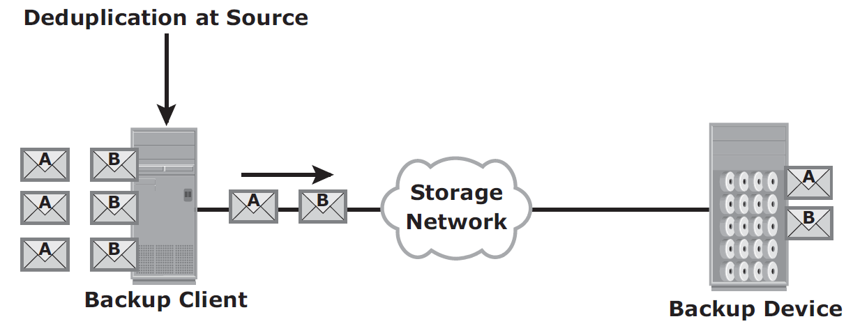
Backup and Archive
Data Deduplication for Backup
Data Deduplication Implementation
Source-Based Data Deduplication

Slide 158
Backup and Archive
Data Deduplication for Backup
Data Deduplication Implementation
Source-based deduplication increases the overhead on the backup client, which impacts the performance of the backup and application running on the client.
Source-based deduplication might also require a change of backup software if it is not supported by backup software
Target-Based Data Deduplication
Target-based data deduplication is an alternative to source-based data deduplication.
Target-based data deduplication occurs at the backup device, which offloads the backup client from the deduplication process.

Slide 159
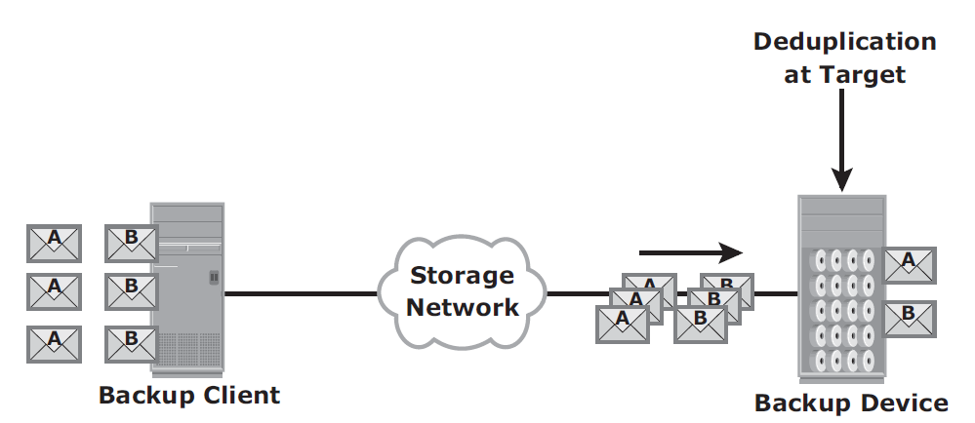
Backup and Archive
Data Deduplication for Backup
Data Deduplication Implementation
Target-Based Data Deduplication

Slide 160
Backup and Archive
Data Deduplication for Backup
Data Deduplication Implementation
In this case, the backup client sends the data to the backup device and the data is deduplicated at the backup device, either immediately (inline) or at a scheduled time (post-process).
Because deduplication occurs at the target, all the backup data needs to be transferred over the network, which increases network bandwidth requirements.
Target-based data deduplication does not require any changes in the existing backup software.

Slide 161
Backup and Archive
Data Deduplication for Backup
Data Deduplication Implementation
Inline deduplication performs deduplication on the backup data before it is stored on the backup device.
Hence, this method reduces the storage capacity needed for the backup.
Inline deduplication introduces overhead in the form of the time required to identify and remove duplication in the data.
So, this method is best suited for an environment with a large backup window.

Slide 162
Backup and Archive
Data Deduplication for Backup
Data Deduplication Implementation
Post-process deduplication enables the backup data to be stored or written on the backup device first and then deduplicated later.
This method is suitable for situations with tighter backup windows.
However, post-process deduplication requires more storage capacity to store the backup images before they are deduplicated.

Slide 163
Backup and Archive
Backup in Virtualized Environments
In a virtualized environment, it is imperative to back up the virtual machine data (OS, application data, and configuration) to prevent its loss or corruption due to human or technical errors.
There are two approaches for performing a backup in a virtualized environment:
  the traditional backup approach and
  the image-based backup approach.

Slide 164
Backup and Archive
Backup in Virtualized Environments
In the traditional backup approach, a backup agent is installed either on the virtual machine (VM) or on the hypervisor.
If the backup agent is installed on a VM, the VM appears as a physical server to the agent.
The backup agent installed on the VM backs up the VM data to the backup device.
The agent does not capture VM fi les, such as the virtual BIOS file, VM swap file, logs, and configuration files.
Therefore, for a VM restore, a user needs to manually re-create the VM and then restore data onto it.

Slide 165
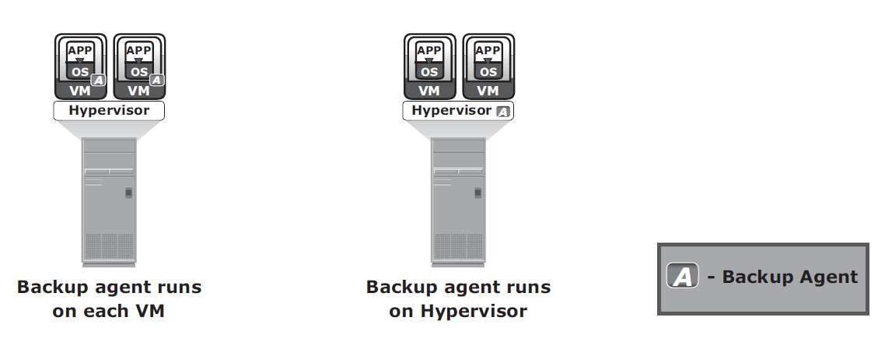
Backup and Archive
Backup in Virtualized Environments
Traditional VM backup

Slide 166
Backup and Archive
Backup in Virtualized Environments
If the backup agent is installed on the hypervisor, the VMs appear as a set of files to the agent.
So, VM files can be backed up by performing a file system backup from a hypervisor.
This approach is relatively simple because it requires having the agent just on the hypervisor instead of all the VMs.
The traditional backup method can cause high CPU utilization on the server being backed up.
In the traditional approach, the backup should be performed when the server resources are idle or during a low activity period on the network.
Also consider allocating enough resources to manage the backup on each server when a large number of VMs are in the environment.

Slide 167
Backup and Archive
Backup in Virtualized Environments
Image-based backup operates at the hypervisor level and essentially takes a snapshot of the VM.
It creates a copy of the guest OS and all the data associated with it (snapshot of VM disk files), including the VM state and application configurations.
The backup is saved as a single file called an “image,” and this image is mounted on the separate physical machine–proxy server, which acts as a backup client.
The backup software then backs up these image files normally.
This effectively offloads the backup processing from the hypervisor and transfers the load on the proxy server, thereby reducing the impact to VMs running on the hypervisor. Image-based backup enables quick restoration of a VM.

Slide 168
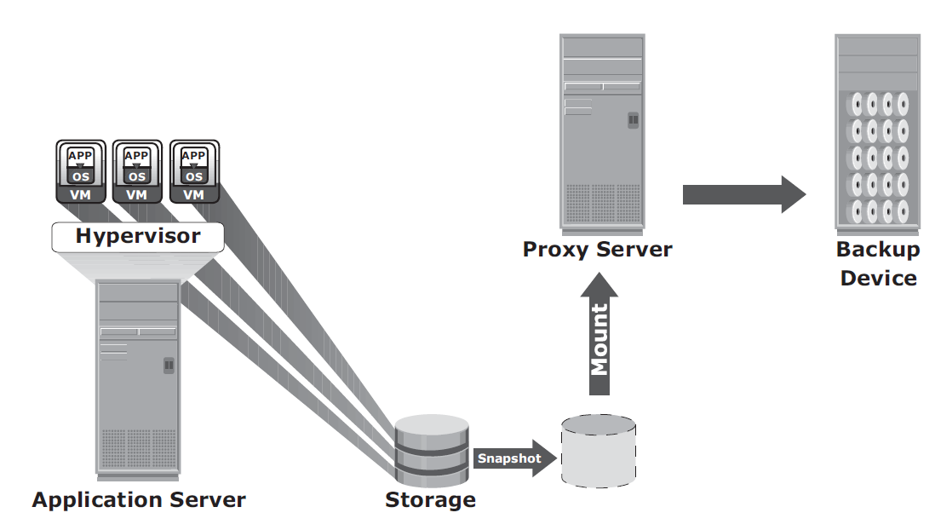
Backup and Archive
Backup in Virtualized Environments
Image-based backup

Slide 169
Backup and Archive
Backup in Virtualized Environments
The use of deduplication techniques significantly reduces the amount of data to be backed up in a virtualized environment.
The effectiveness of deduplication is identified when VMs with similar configurations are deployed in a data center.
The deduplication types and methods used in a virtualized environment are the same as in the physical environment.

